Slide 1

Stage 5 Evaluation: Deployment & User Experience
Project Name: EventHub
Prepared & Presented By: Group 2
Team Members:
202412013 - Parth Chauhan
202412026 - Jain Tisha Navinkumar
202412029 - Joshi Preksha Sanjaybhai
202412032 - Kaival Shah
202412066 - Patel Dhruv Alkeshbhai
202412079 - Rajvi Khatri
202412101 - Shah Yashvi Devangkumar
202412119 - Ritik Kalal

Slide 2

Stage Objective
To evaluate the operational readiness, usability, and user experience of the deployed system.
This includes:
🔹 Demonstration of the fully deployed platform
🔹 Explanation of deployment workflow
🔹 UI/UX walkthrough and user journey
🔹 Performance, scalability, and security assessment
Outcome expected: A production-ready system that users can access publicly without local setup.

Slide 3
Overall Deployment Architecture
Two-tier Deployment Model:
Component
Hosting Service
Deployment Tech
Status
Frontend
Vercel
Build + Auto Deploy
Live
Backend API
Render Cloud
Docker Container
Live
Code Repository
GitHub
CI-friendly
Active
Database _(if used)_
MongoDB Atlas
Cloud hosted
Connected
Key Highlights:
✔ Fully cloud hosted (No local execution required)
✔ Individually deployable Frontend & Backend
✔ Version-controlled, auto-deploy enabled architecture

Slide 4
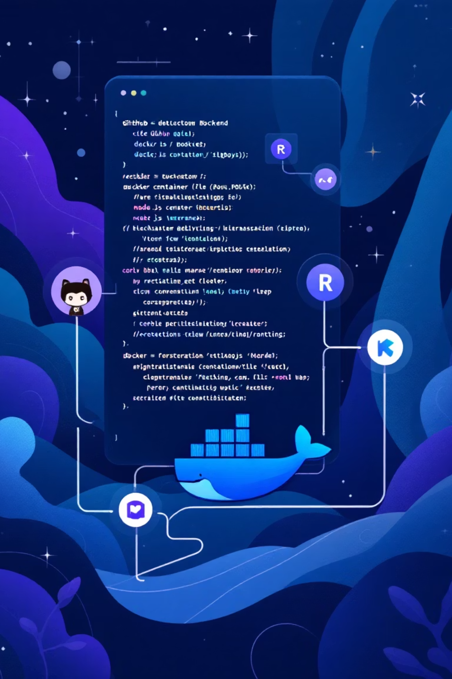
Backend Deployment:
Render + Docker
Technology Stack: Node.js / Express (or your backend language), REST API, Docker, GitHub, Render
Deployment Steps Performed:
Backend source code containerized through Dockerfile
Built Docker image → tested locally for stable runtime
Repository pushed to GitHub
Connected Render service with GitHub repo
Defined build commands + start command in Render dashboard (blueprint)
Added environment variables securely through Render UI
Successful deployment generated production API endpoint
Webhook configured → deployment triggers automatically after each commit
Live Backend Deployment URL:-
https://eventhub-backend-k9ir.onrender.com/api/events

Slide 5
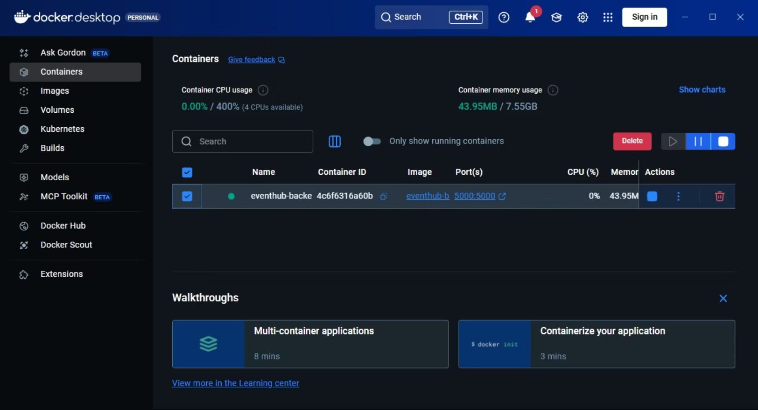
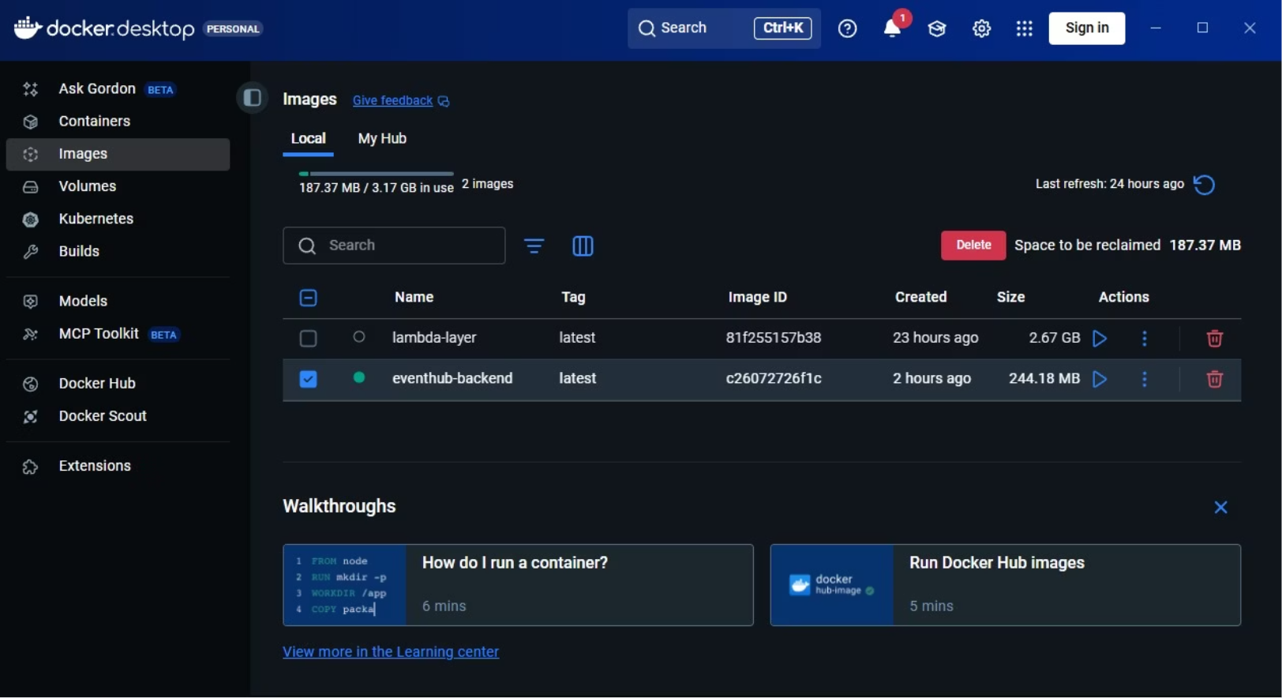
Docker Implementation

Slide 6
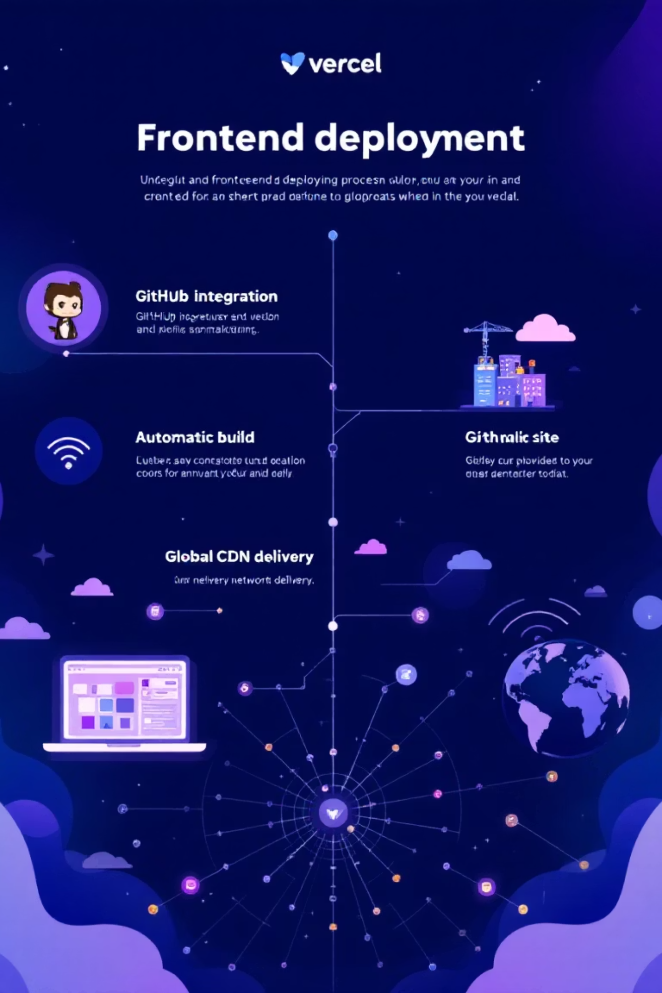
Frontend Deployment on Vercel
Frontend Stack: React.js / HTML-CSS-JS
Deployment Procedure:
GitHub repository imported to Vercel
Framework auto-detected → build commands configured automatically
Production environment variables (API URL) added
Build succeeded → automatic domain assigned
Testing performed to ensure successful API integration
URL made public for external usage/testing
Benefits of Vercel Deployment:
⚡ Fast global CDN → low latency UI
📂 Automatic build + version rollback capability
📱 Easy preview deploys for every feature update
✔ Zero-downtime deploys

Slide 7
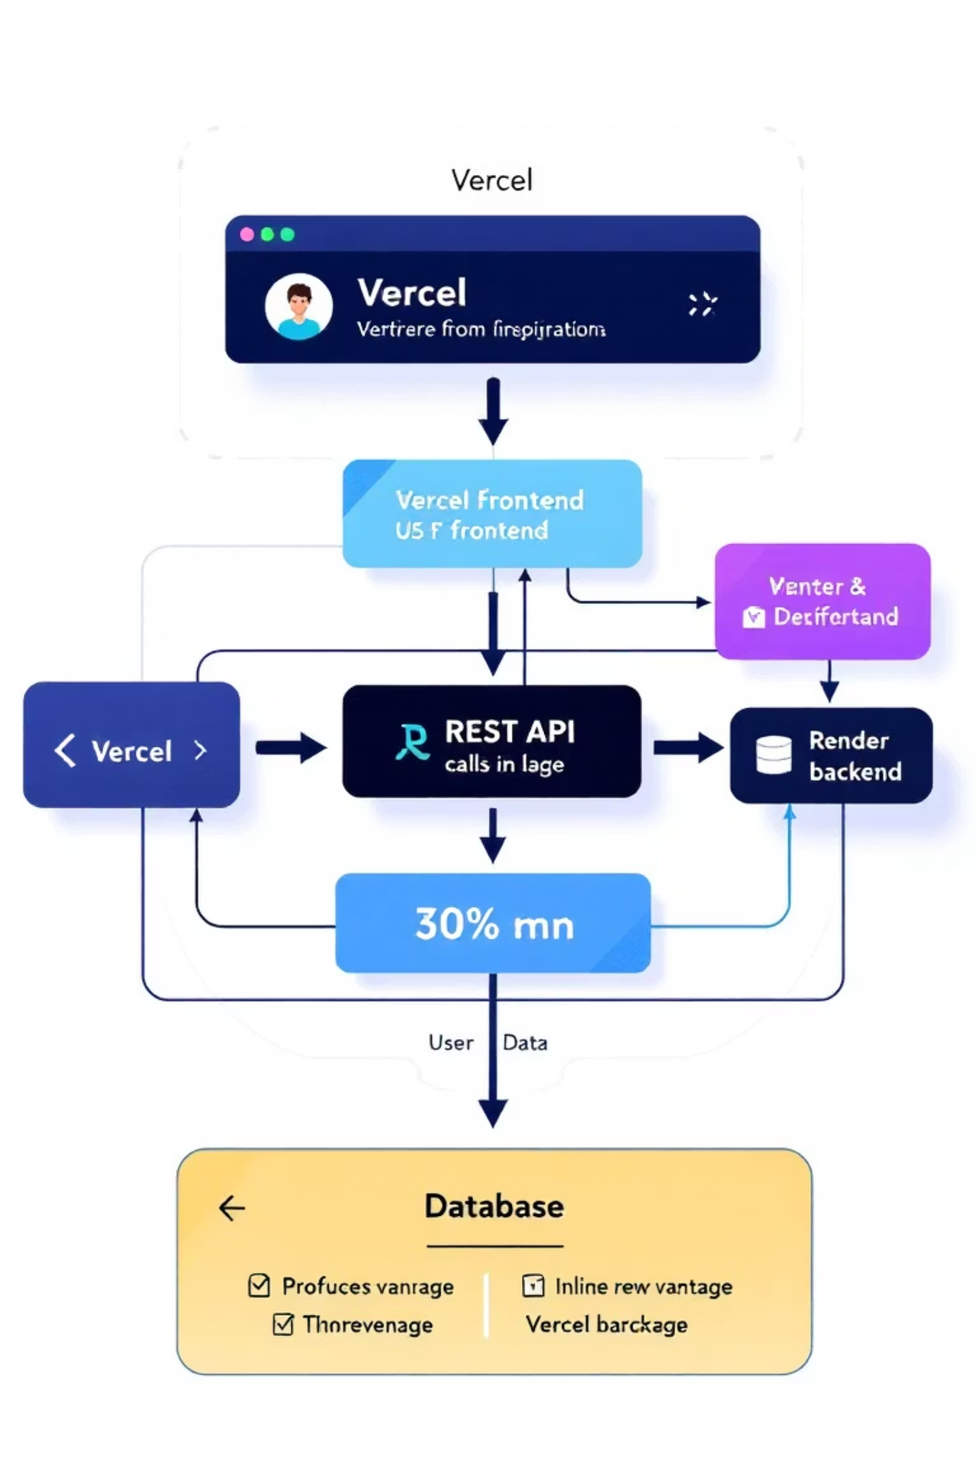
Integration Workflow
How Frontend & Backend Talk:
User → Vercel-hosted UI → REST API calls → Render Backend Container → Database → Response to UI
✔ API endpoints consumed directly from deployed backend
✔ Tested with real-time requests (GET/POST/PUT/DELETE)
✔ Seamless CORS policy enabled for communication

Slide 8

Live Demo Flow
We will showcase the real-time deployed system:
Load deployed frontend website
Explore navigation panels & responsive layout
Perform core features (Registration/Login/Booking/Listing etc.)
Show API interaction through Network tab/console
Display production Render API URL response
Edge case handling (invalid input, authentication)
Optional: Show infrastructure logs from Render + Vercel
User POV → Can access system anywhere using just the link. No installation required.
Project Deployment Link: event-hub-olive.vercel.app

Slide 9

UI/UX Walkthrough
Focus Areas:
🎨 Clean & intuitive interface
📱 Fully responsive layout for desktop + mobile
🧭 Clear navigation structure with minimal clicks
🔍 Visibility of key actions (Sign Up, Explore, Profile etc.)
💬 Feedback-driven alerts, error prompts, success toasts
Goal: A frictionless user experience for both new and recurring users.

Slide 10

Performance & Security Considerations
🔹Performance Enhancements:
Global CDN delivery → reduces UI load time
Optimized Docker image size → faster container spinup
Pagination / caching (if implemented) reduces heavy calls
Lazy loading for large components
🔹 Security Implementations:
API keys & credentials hidden using env variables
HTTPS enforced endpoints
Authentication for protected routes
Input validation to prevent malicious requests
Rate-limiting / JWT / CORS policies

Slide 11

Conclusion
Our deployment is live, stable, scalable and production-ready.
✔ Frontend successfully deployed via Vercel
✔ Backend dockerized & deployed on Render
✔ End-to-end functional integration achieved
✔ UI/UX tested for usability and performance
The system can now be accessed publicly by evaluators anytime.

Slide 12

THANK YOU FOR YOUR ATTENTION!
💬 Open for Questions?📥 Feedback Welcome.

